Slide 1
Noise Measurements
Microwave Measurement Systems
A_M17MMS
Přemysl Hudec
CTU Prague, Faculty of Electrical Engineering
hudecp@fel.cvut.cz
version 2013

Slide 2
Contents
Noise figure definitions
Equivalent noise temperature
Frii's formula
Noise figure of passive components
Noise figure measurement principles
Switched noise sources
HP8970A noise figure meter
Measurement setup
Calibration and correction
Measurement at higher frequencies
Reflections in measurement path
Advanced calibration and correction

Slide 3
Noise Measurements
Important in case of circuits processing very low-level signals
Often signals below -100dBm
Important S/N ratios on demodulator inputs – decisive for BER
Important sources of noise in radio systems:
  Background radiation - ~ 300K in case of terrestrial radio-link
  Antenna and feeder losses
  Noise contribution of the LNA, receiver
For the LNA design – transistor noise parameters (F_{min}, R_{n}, Γ_{opt})
In this course – measurement of F and T_{e}

Slide 4
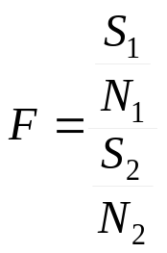
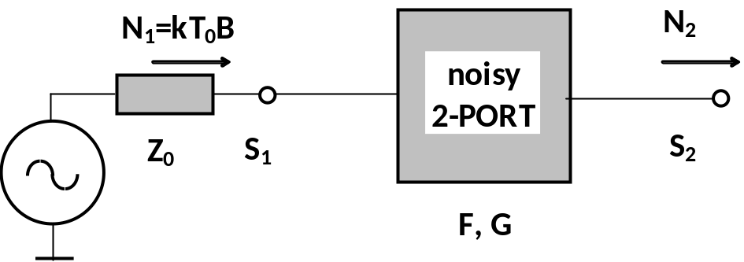
S/N Noise Figure Definition
Definition based on S/N ratios:
S₁ input signal power
N₁=kT₀B definition input power = available noise power of the matched load (ML)!!!
S₂ output signal power
N₂ total output noise power
k Boltzman's konstant k=1,38.10⁻²³ J/K
T₀ noise definition temperature, T₀=290K
B noise frequency bandwidth
S/N definition suitable for system calculations
Not suitable for measurement and general description of circuits with unknown signal

Slide 5
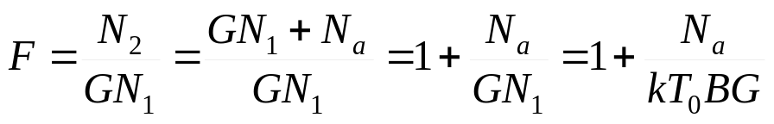

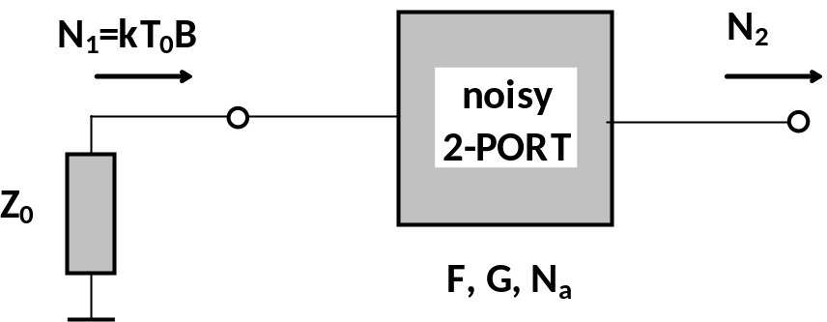
Power Noise Figure Definition
Definition based on noise powers:
G 2-port available gain (G_{a}), if well matched – insertion gain G=S₂/S₁
GN₁ amplified noise power from the input ML
N_{a} noise added by the 2-port (related to output)
N₂ total output noise power
Suitable for general description of circuits with unknown signals
Suitable for measurement
Often expressed in dB:

Slide 6
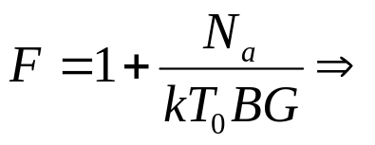





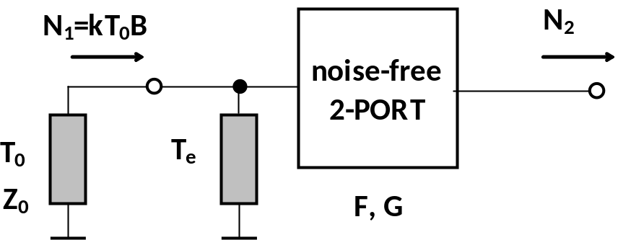
Equivalent Noise Temperature
From the F definition
All inner 2-port noise sources are removed and replaced by an additional virtual load with noise temperature T_{e}
T_{e} caused noise power at output is
Using comparison N_{a}=N_{a}
Equivalent noise temperature
Used in case of low F values (radio-astronomy)
Necessary for system noise calculations including influences of antennas
Example:
F=1,1 (0,41dB) T_{e}=29K
F=1,15(0,61dB) T_{e}=43,5K

Slide 7
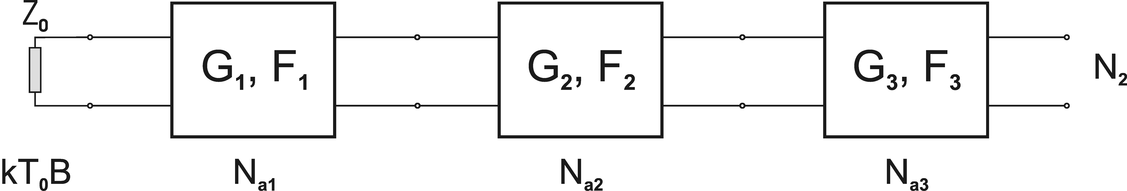



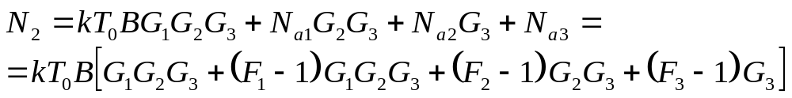
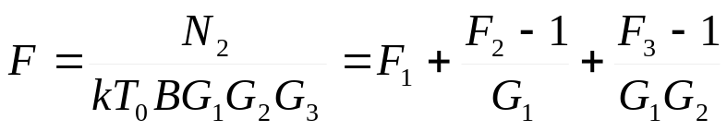
Frii's Formula
Enables calculation of total noise figure of the cascade connection of noisy 2-ports
Inside the cascade – N₁≠kT₀B!!! ,therefore S₁/N₁ ≠F.S₂/N₂
N_{a} can be used – related to input
Frii's formula can be extended to any number of cascaded 2-ports
Important for calculations of both radio and measurement cascades

Slide 8
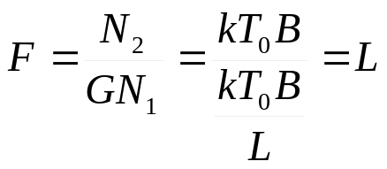
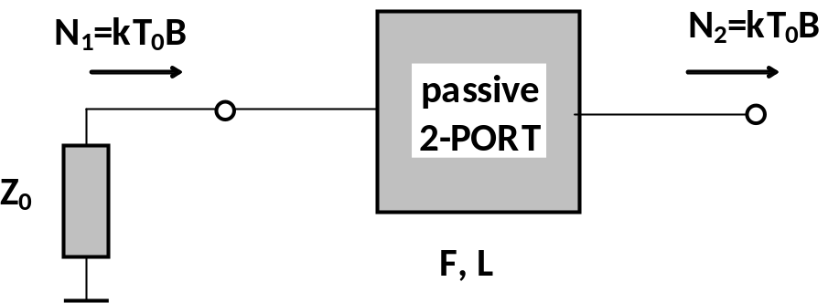
Noise Figure of Passive Components
Regarding N₂, any passive well matched 2-port behaves like the matched load N₂=kT₀B
Noise figure
Noise figure of any well matched passive component is equal to its loss
Attenuators, cables, filters (in pass-band)
But also splitters, directional couplers, etc. with other ports matched
In dB:
F_{dB}=L_{dB}

Slide 9

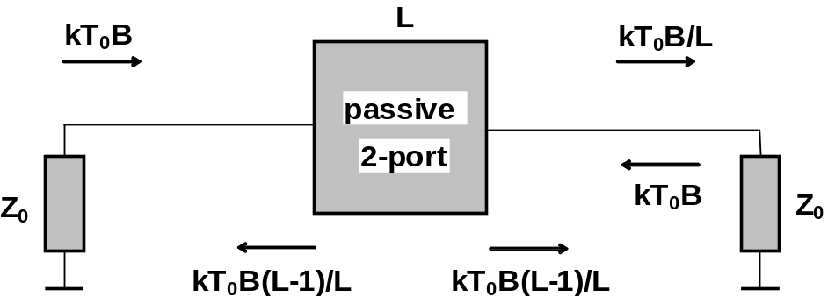


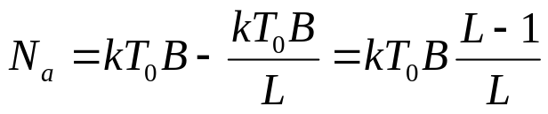
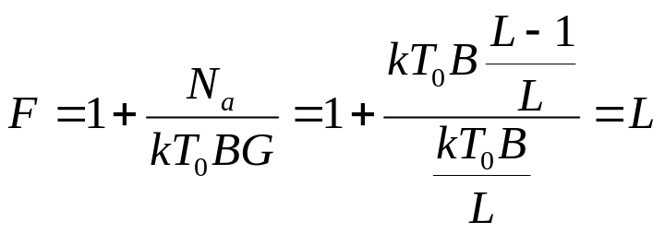
Noise Figure of Passive Components
Physical point of view
Left ML generates power
N₁ is partly absorbed in the 2-port, the part is absorbed in the right ML
The right ML transmits to opposite direction → cooling down
The passive 2-port must generate to both directions added noise power N_{a}
Noise figure

Slide 10
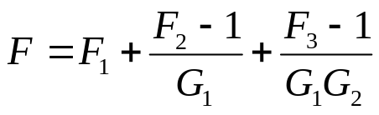


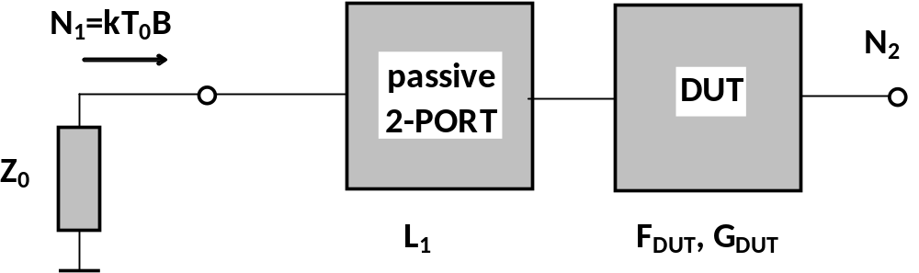
Consequences of Frii's Formula
Any attenuation in the measurement setup influences total noise figure
Noise figure of the measurement receiver influences total noise figure
For precise measurement – all parasitic influences must be calibrated and corrected for
Example: Measured noise figure with attenuation in front of the DUT
Frii's formula
Correction

Slide 11
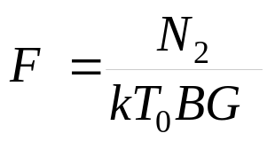
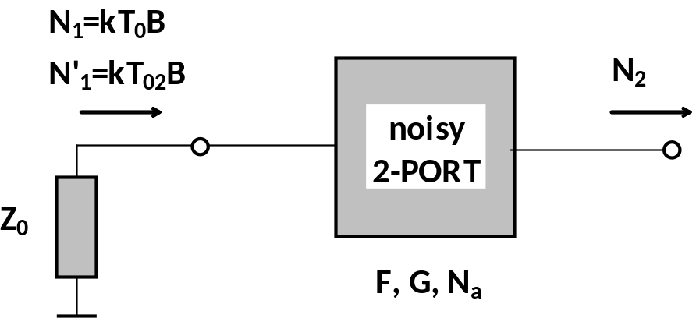
Noise Figure Measurement Principles
F is measured according to its definition – measurement of noise power N₂ with ML at DUT's input
In parallel, it is necessary to measure G!!!
Possibilities:
  VNA – is able to measure both G and N₂ (COLD measurement)
  Usage of 2 different noise temperatures of the input ML → T₀ and T₀₂ (HOT/COLD measurement)
T₀ , T₀₂ can be realized with 2 MLs, one at 290K, other e.g. at 77K (liquid nitrogen)
Used for very precise (calibration) measurements of low F , but lengthy
Usually, switched noise sources based on noise diodes are used

Slide 12
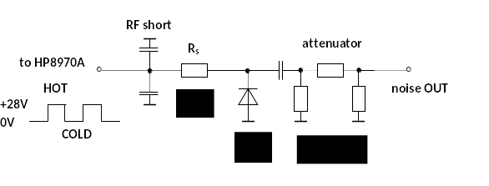
Switched Noise Sources
Based on noise diodes – high noise generation, low inner capacitances
Noise diode is operated with the reverse bias – avalanche break-down area
Output attenuator:
  Wideband impedance matching
  Realizes Z₀ in both the HOT/COLD states
COLD state – no I_{d} current, no additional noise, behaves like ML, noise temperature T₀
HOT state – I_{d} current limited by R_{s}, high additional noise, noise temperature T₀₂
Can be easily switched by a square-wave driving voltage, typ. 0/+28V

Slide 13

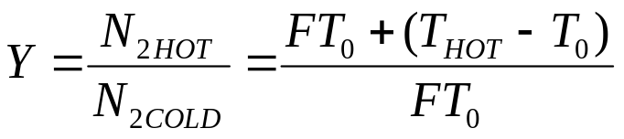
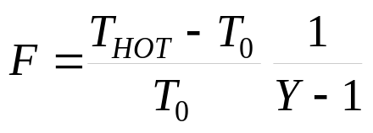
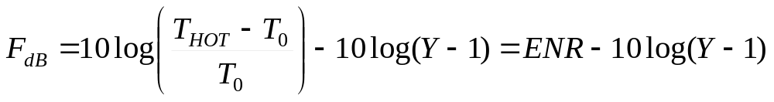
Noise Figure Measurement
COLD state measurement
HOT state measurement
The NFM evaluates ratio:
From Y → F can be calculated:
ENR is important parameter of the noise-source used, common values 5 - 20dB
ENR [dB] T_{HOT} [K]
5 1206
10 3190
15 9461
20 29290

Slide 14

Noise source HP346B - Parameters
Frequency band 10MHz – 18GHz
ENR typ. 15dB, calibration table available
ENR neurčitost <0,1dB
ENR temperature variations <0,01dB/°C
SWR
  10-30 MHZ <1,3
  30-5000 MHz <1,15
  5-18GHZ <1,25
Biasing 28V/30mA in the HOT state

Slide 15
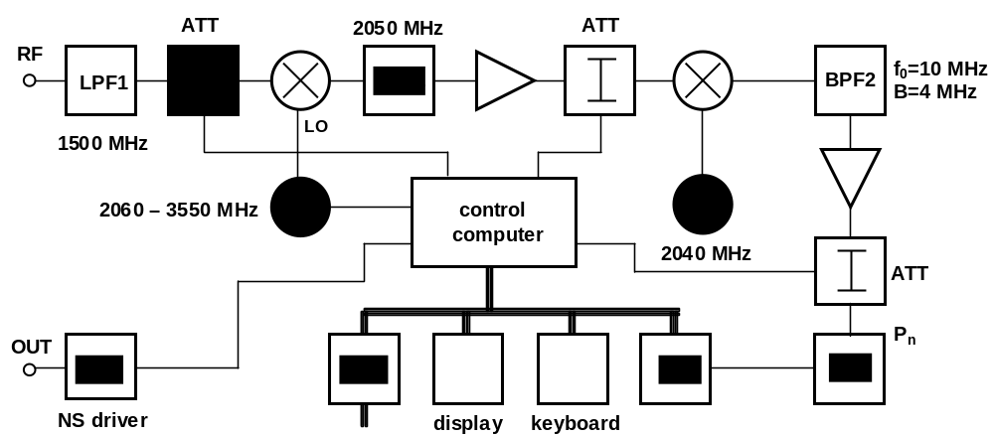
HP8970A Noise Figure Meter
Measurement receiver-noise power meter with NS driver
Input frequency band 10 – 1500 MHz, B=4MHz
Multiple-mixing structure – ensure suppression of the mirror frequency band
Noise power measured by detector at f_{MF2}=10MHz, A/D conversion
Amplifiers together with switched attenuators set optimum processing gain
Computer, simple keyboard and display, HP-IB driver
For higher frequencies – external mixer and LO must be used

Slide 16
HP8970A - Parameters
Frequency band 10 – 1500MHz
Frequency step 1MHz
Own noise figure F_{NFM} 7dB
Input PSV <1,7
Max. input power -10dBm
Max. external gain 65dB
F measurement range 0-30dB
Rozlišitelnost F ±0,01dB @G_{a}>-10dB
Neurčitost typ. 0,1dB
Noise bandwidth B 4MHz
Sensitivity kT₀BF_{NFM} -100dBm
Measured parameters F, F_{dB}, T_{e}, Y, Y_{dB}
External LO control up to 60GHz

Slide 17







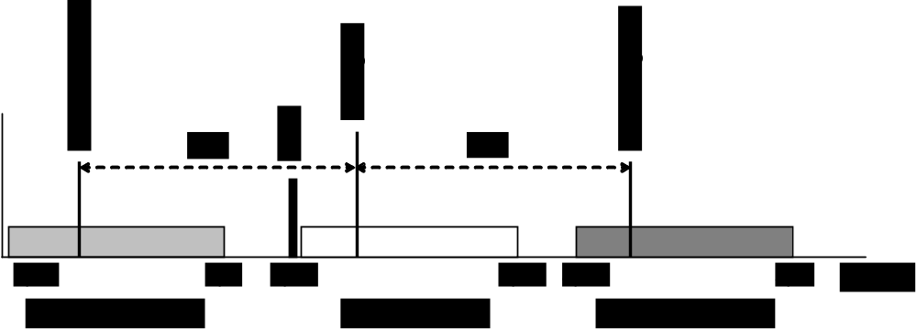
HP8970A Frequency Plan
Multiple mixing structure – ensures rejection of the mirror frequency band
The first mixer performs up-conversion to
  For measurement at LO frequency must be set to
  For measurement at LO frequency must be set to
  The required LO frequency range is 2060 – 3550 MHz
Mirror frequencies are distanced by from f_{LO}
The mirror frequency range is, therefore 4110 – 5600 MHz
The mirror frequencies can be easily suppressed by the fixed LPF1 at the NFM input
The second mixer performs down-conversion to

Slide 18
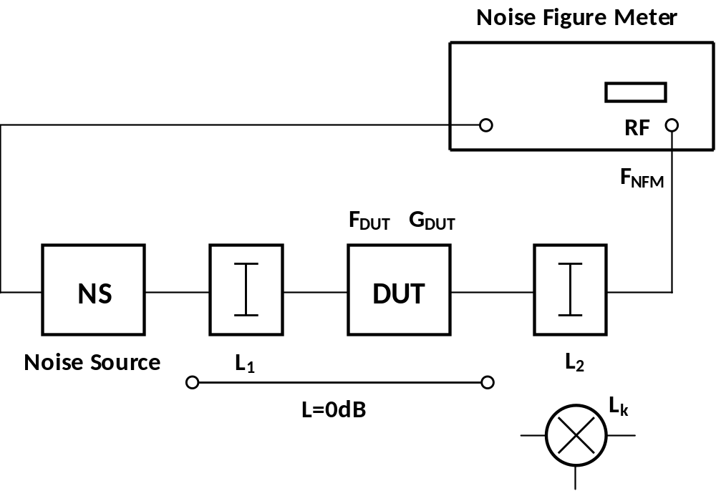
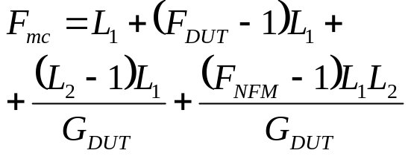
Basic Measurement Setup
Applicable in well matched measurement setups
L₁ – attenuation in front of DUT
L₂ – attenuation (or amplifier with additional gain G_{ad}) behind the DUT
For measurement at higher frequencies, external mixer with L_{k} is used
The total measured noise figure
F_{DUT} should be calculated
Calibration&correction is necessary
Frii's formula

Slide 19


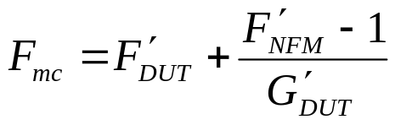
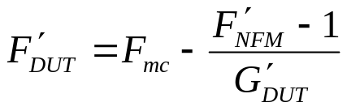


Calibration and Correction
Removes influences of F_{NFM} and attenuations/gain in the measurement path
L₁+DUT replaced by L=0dB adapter – NFM measures , which includes influences of L₂ (or G_{ad}) and F_{NFM}
L₁ cannot be included into calibration – must be corrected subsequently
Correction

Slide 20
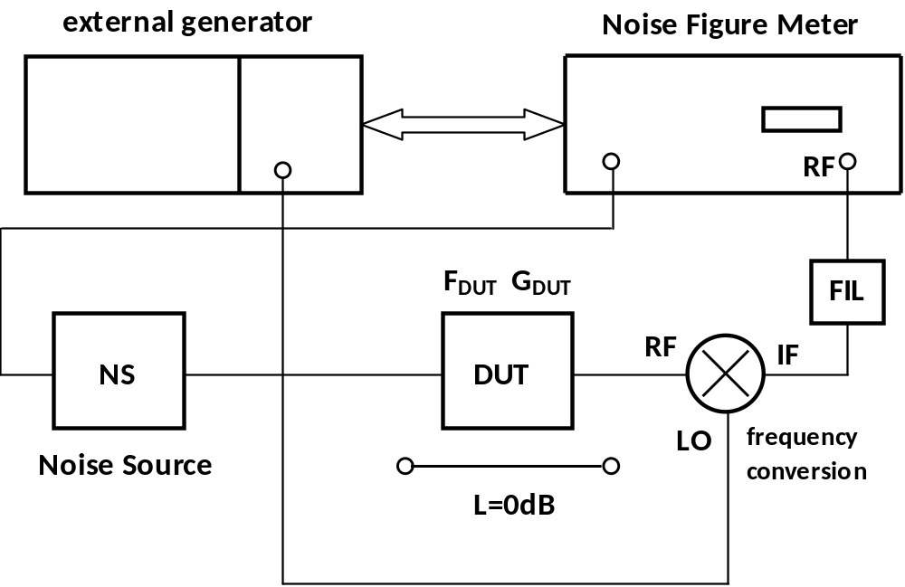
Measurement at Higher Frequencies
External down-conversion is required
External mixer, LO and filter (in SSB measurements) must be used
NFM works as IF unit – receiver
Several operational modes can are applicable

Slide 21
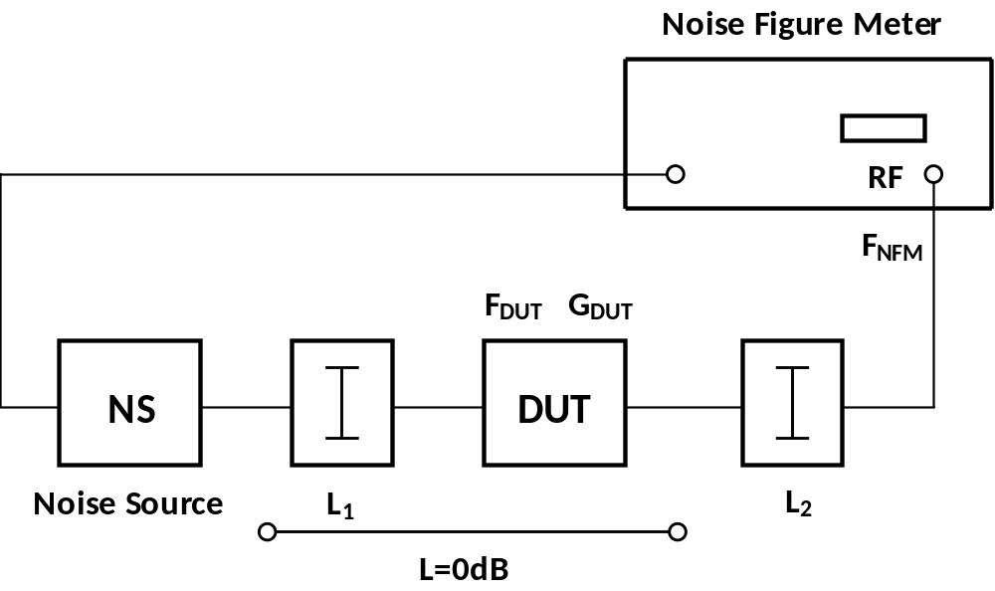
1.0 Measurement Mode
Basic measurement in the 10-1500MHz frequency band
Calibration and correction – above described

Slide 22

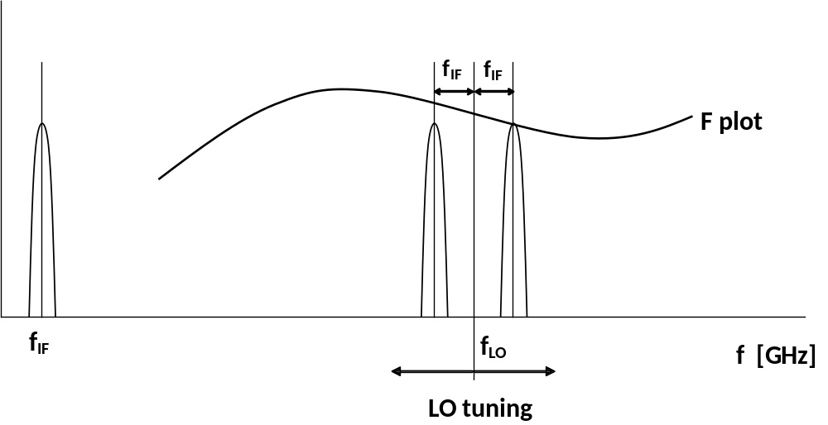
1.1 Measurement Mode
The NFM operates as IF unit at fixed frequency
Variable frequency of the external LO
DSB measurement – NFM shows average F value measured at 4MHz bands
IF frequency should be, therefore, as low as possible

Slide 23
1.1 Measurement Mode
Standard calibration and correction
DUT replaced by L=0dB adapter, NFM measures and stores it into memory
The value includes influences of mixer
FIL is not required

Slide 24
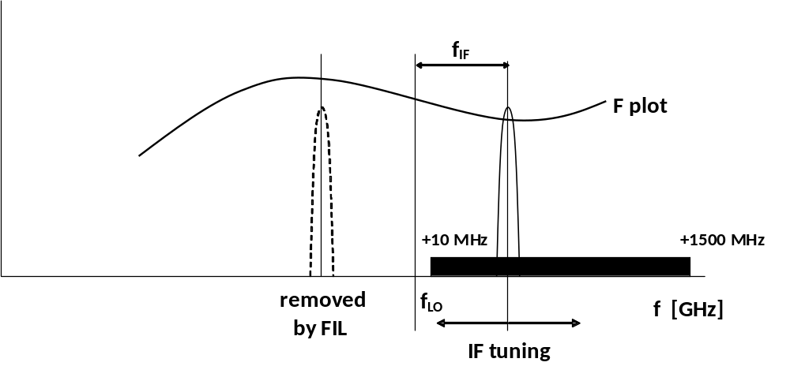
1.2 Measurement Mode
SSB measurement
Fixed frequency of the external LO, variable IF frequency (tuned NFM)
FIL required
Suitable if steep changes of F are present
But narrow frequency range
Identical calibration and correction as 1.1 mode

Slide 25
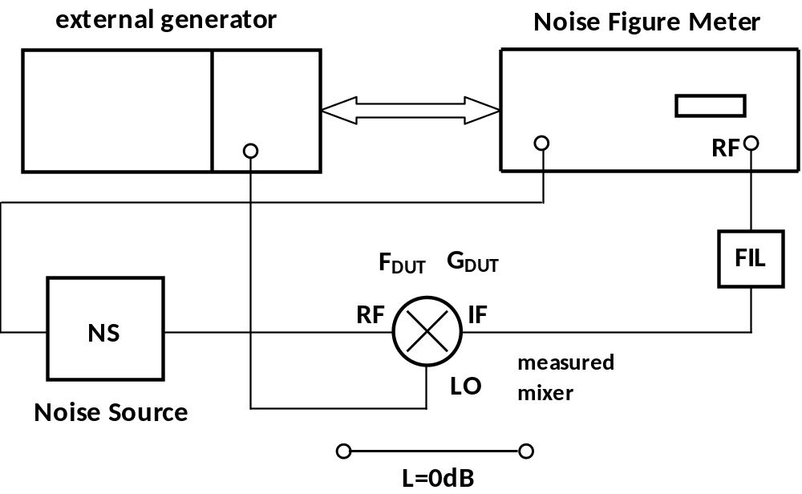
1.3 Measurement Mode
Frequency conversion within the DUT, DSB measurement, fixed f_{IF}, variable f_{LO}
Differences in calibration – direct NS and NFM connection
FIL not required
NFM employs:
  During calibration – ENR at f_{IF}
  During measurement – ENR at f_{RF}

Slide 26
1.4 Measurement Mode
Similar as 1.3 mode
Frequency conversion in the DUT, but SSB measurement
LO frequency fixed, IF frequency variable
FIL required

Slide 27




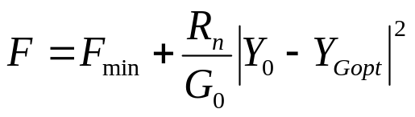
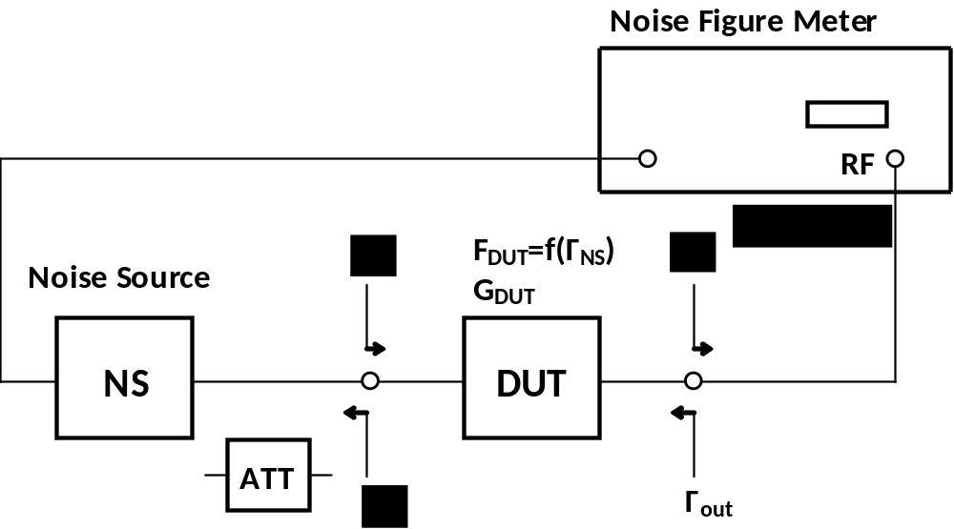
Reflections in Measurement Path
All the above described measurement steps and setups work well if all components including DUT's output are very well matched – not always reality
Practical problems:
  NS → difference between HOT and COLD states must be negligible
  Output of NS must be Z₀ exactly – impedance F reference
  Can be solved/improved by additional attenuator ATT – but reduces ENR
  Relatively small problems with , if , the same influence on Y
  More significant are influences of !!!

Slide 28
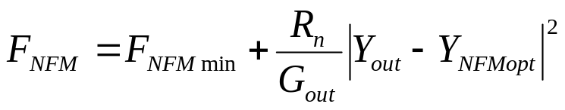




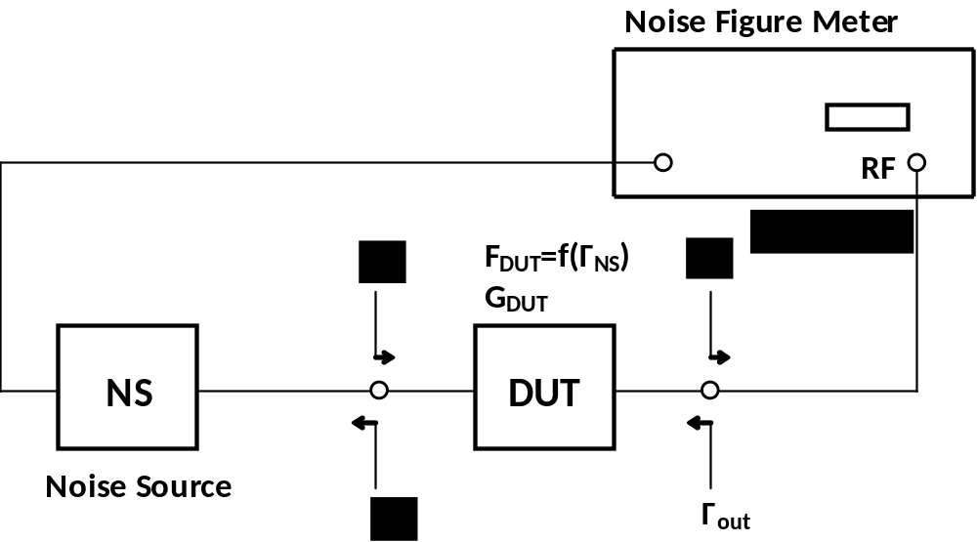
Reflections in Measurement Path
Problems at DUT output:
  F_{NFM} is a function of (or Y_{out})
  During calibration, is measured
  During DUT measurement is measured
  In noise figure definition formulas, available gain G_{a} is used
  G_{a} is defined with complex conjugated matched load
  But during standard calibration, insertion gain with is measured
Solution → advanced calibration and correction

Slide 29



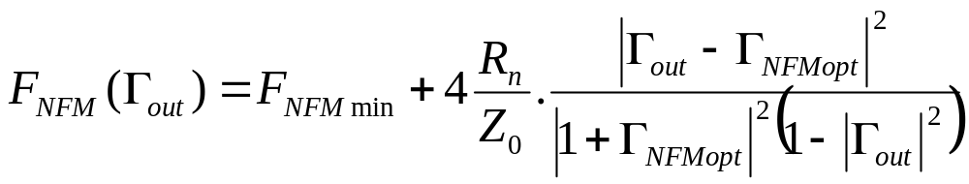
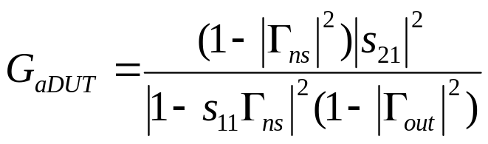

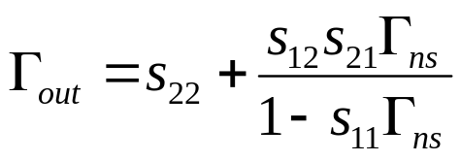
Advanced Calibration and Correction
Noise parameters of NFM must be measured:
With NFM noise parameters known, can be calculated
G_{aDUT} can be calculated from s-parameters of the DUT

Slide 30
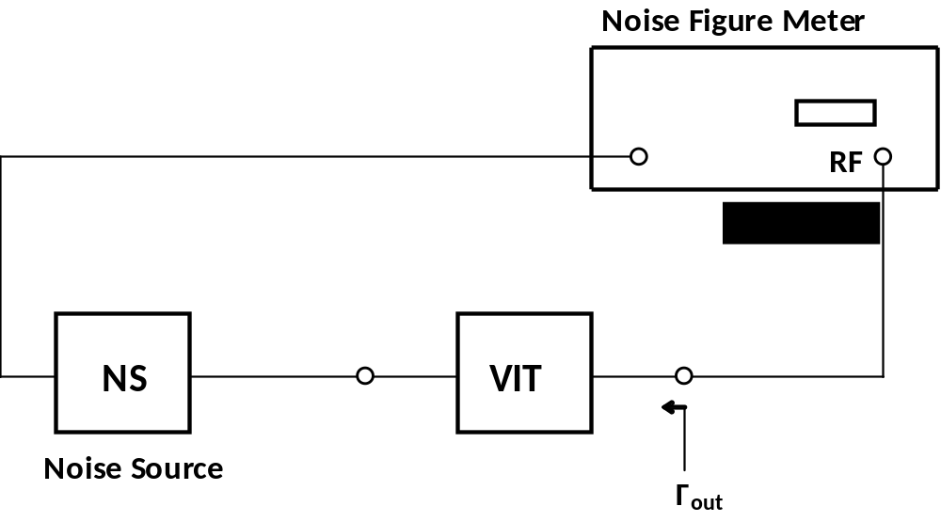
Practical Implementation
Rather complex
Noise parameters can be measured using variable impedance transformer (VIT)
F is measured for a series of different values
From that, noise parametrs can be calculated
DUT s-parameters can be measured by using VNA
VNA with the noise figure measurement option (COLD method) is the best choice

